Slide 1

Covid Death Rates Analysis
Travis Lindeman

Slide 2
Agenda
Stakeholder Interest
Data of Interest
EDA
Hypothesis Testing and Regression: Vaccination Rates vs Covid Deaths
Analysis of Ancillary Factors
Conclusion
Way Forward
Contact and Repository

Slide 3
Stakeholder interest
Gauge future pandemic response
Target most vulnerable populations
Inform decision making by understanding at-risk societies

Slide 4
Dataset and cleaning
35 Columns, 302K Rows
By country data from 1/3/2020 to 4/12/2023
Missing values required using weekly averages in analysis

Slide 5
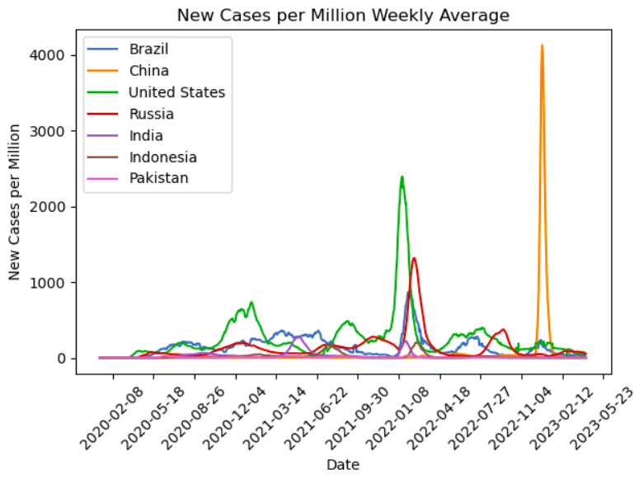
New cases over time
Correlates with China’s “reopening”
Seasonal spikes

Slide 6
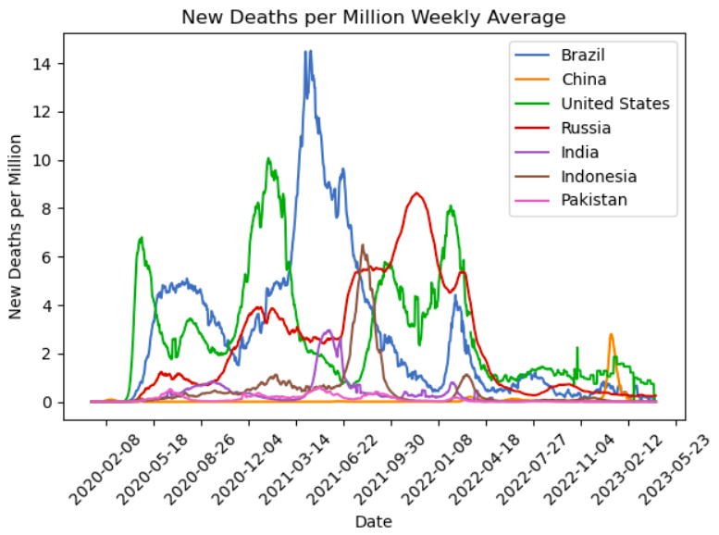
New deaths per million

Slide 7
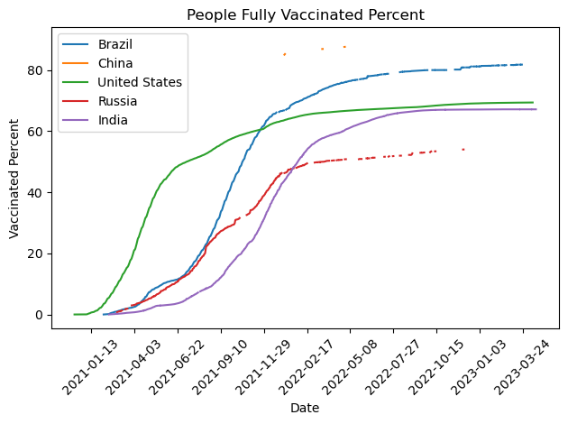
Population vaccination percentage

Slide 8
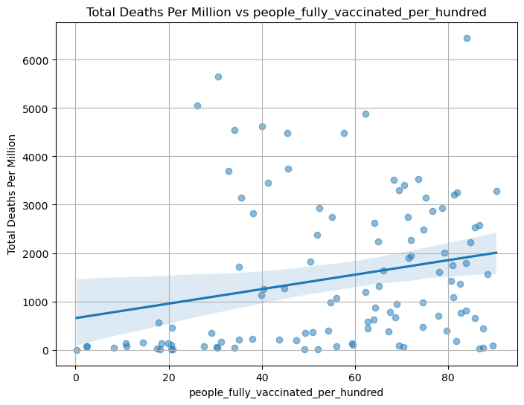
Hypothesis test: Did vaccination rates decrease death rates?
H0: Vaccination rates do not lower the death rate in a country.
Hα: An increase in vaccination rates lowers the death rate in a country.
P-value: 0.012
These readings suggest that we can reject the null hypothesis.

Slide 9
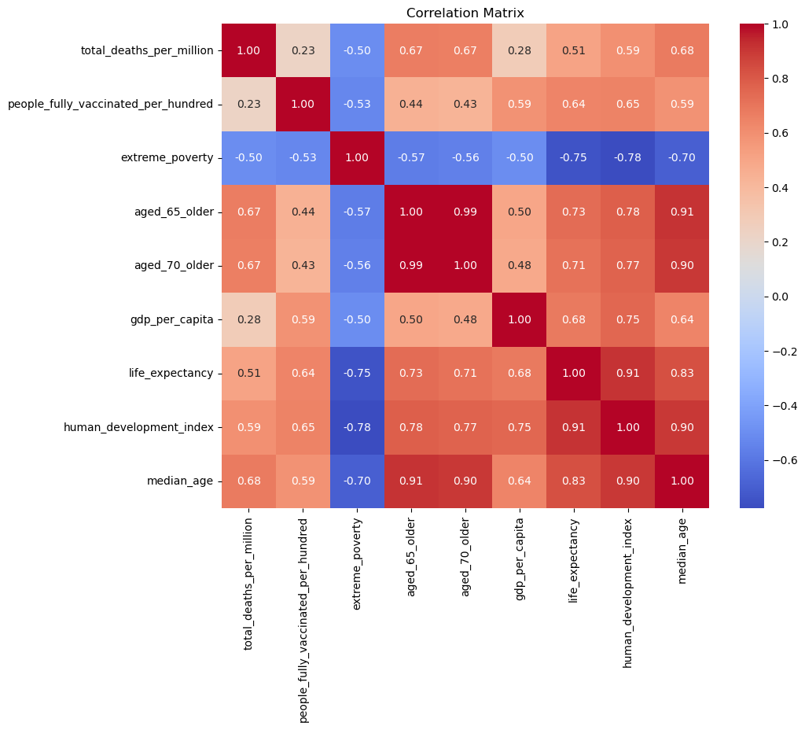
Additional factors affecting death rates
Negatively correlated with extreme poverty
Positively correlated with vaccination rates, increased age, wealthier nations, life expectancy, and human development

Slide 10
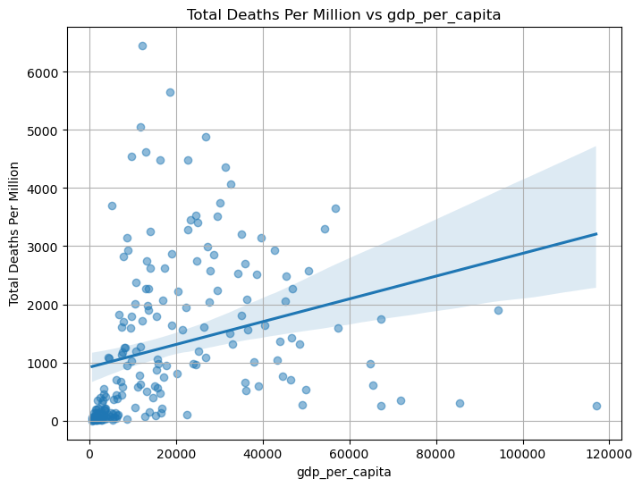
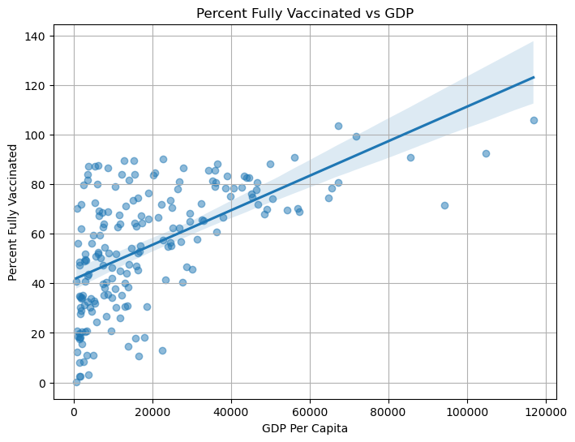
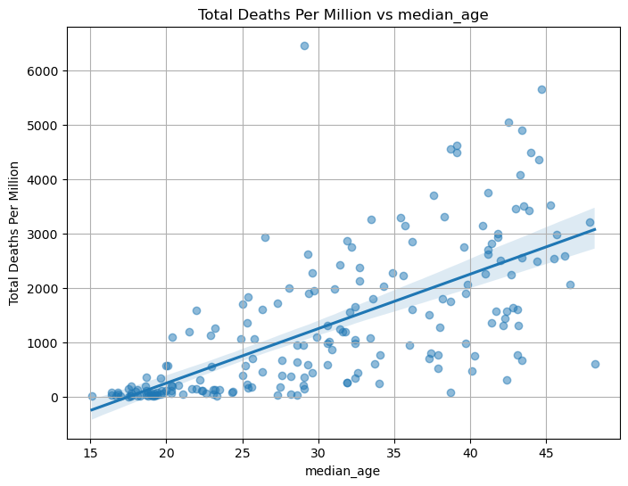
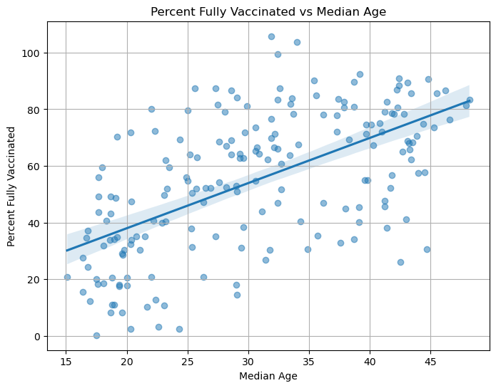
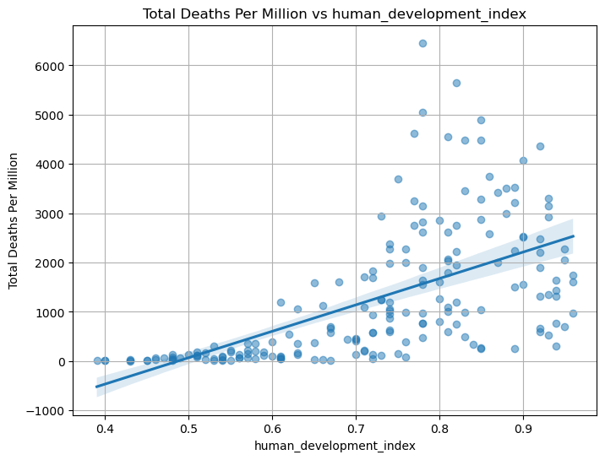
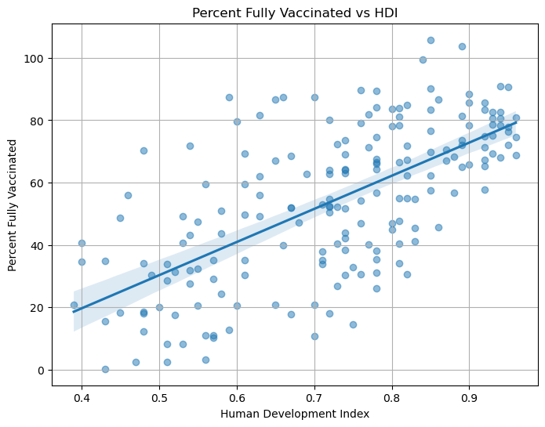
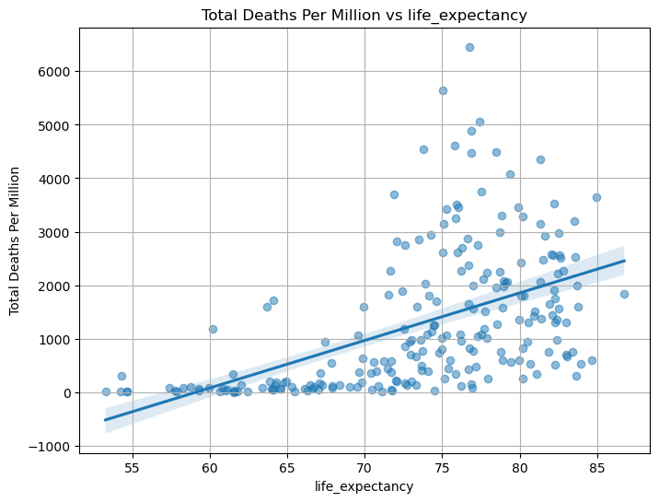
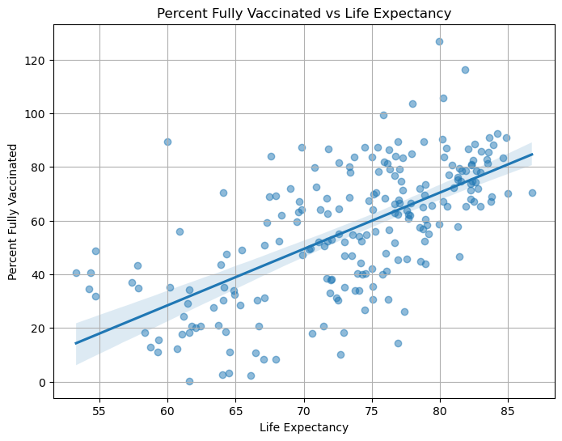

Slide 11
conclusion
Covid vaccinations statistically support a decrease in total deaths, but this is debatable given the array of data which correlates slightly upwards with vaccination rates.
Covid vaccination rates correlate with wealthier and older populations which died at higher rates than poorer and younger populations.
A country’s covid death rates likely have more to do with the vulnerabilities of elderly populations.

Slide 12
Way forward
Assess pandemic intensity over time as opposed to total
Missing from this data is information about deaths by age group which could assist more refined assessments of vulnerable populations

Slide 13
Contact and data links
Contact Info
Travis Lindeman
tralinde@gmail.com
Repository Link
https://github.com/tralinde/covid_data_project
Dataset Link
https://www.kaggle.com/datasets/tohidkhanbagani/covid-19-deaths-and-vaccinations-dataset

